Slide 1
DFM_RAMP_SUB-ASSY_MAGNET_BUD RET_R_B747_613-35102-90
Date: 2025/06/24
Rev.: 04

Slide 2
B747 BUD | Revision list
Rev. | Description | Date
01 | Initial release | 2024/01/18
02 | Change datum B of 2D drawing | 2024/01/24
03 | Optimize the fixture and hot press design, and change step 2 to use Shunt Carrier | 2025/05/09
04 | Update the automatic equipment | 2025/06/24

Slide 3
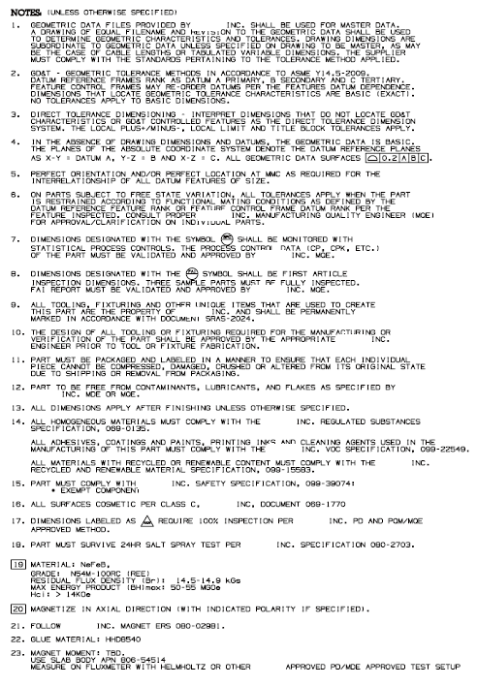
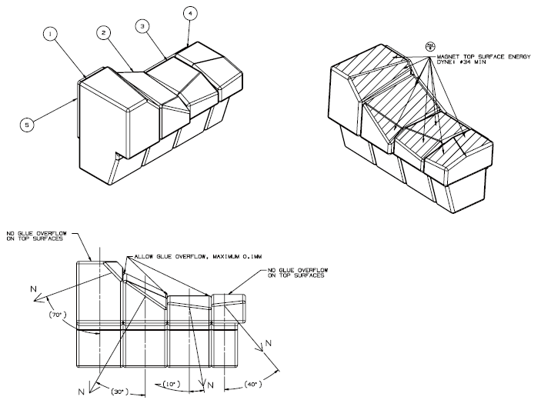
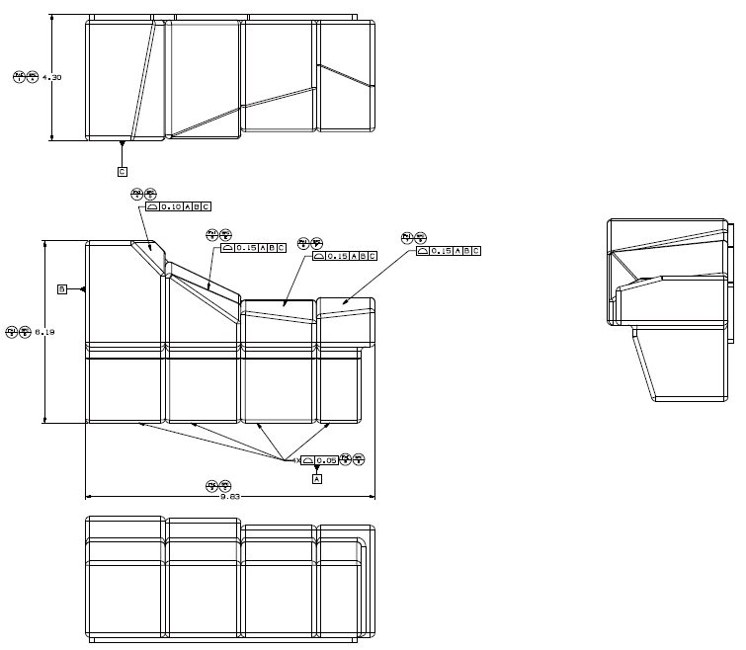

B747 BUD | Product Information

Slide 4
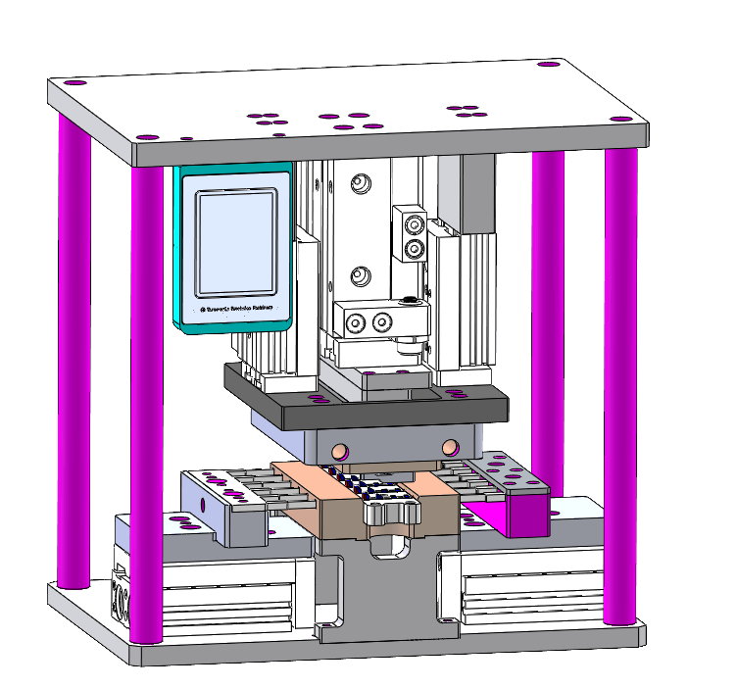
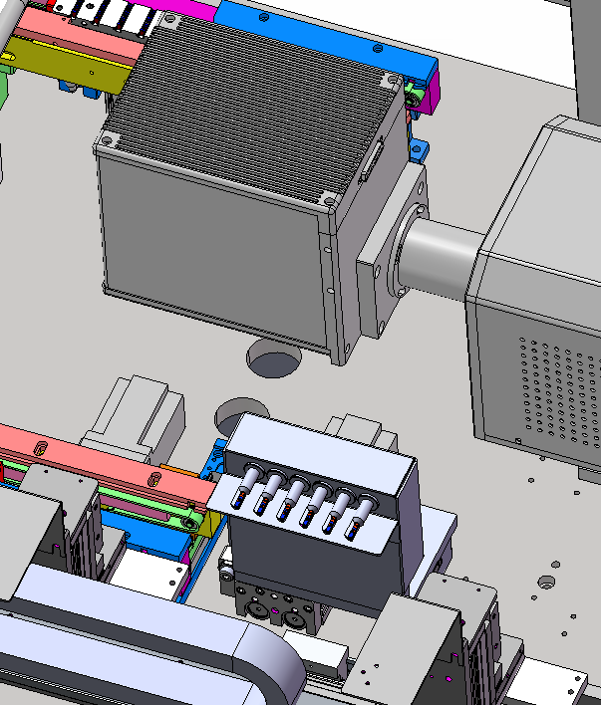
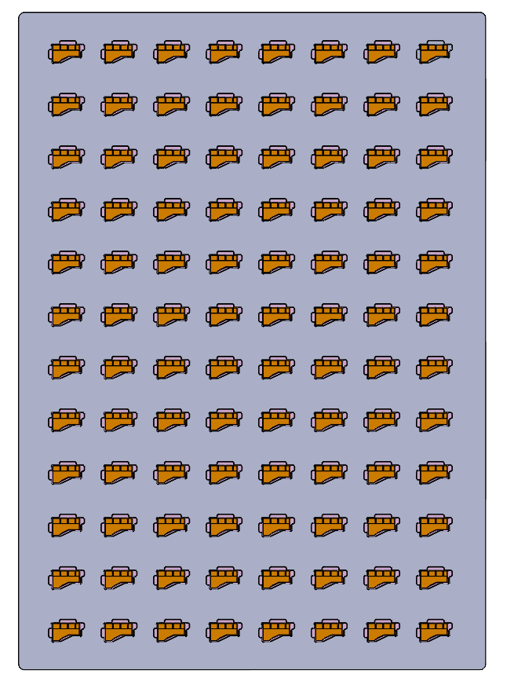
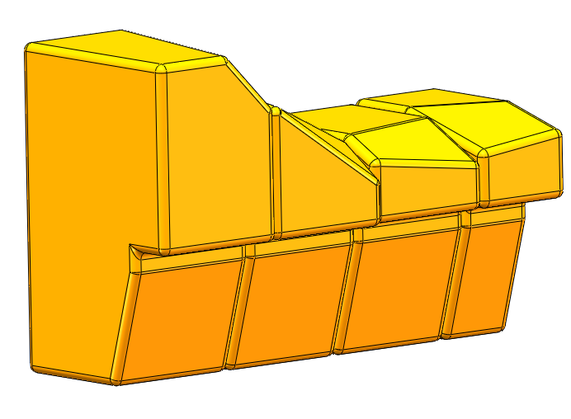
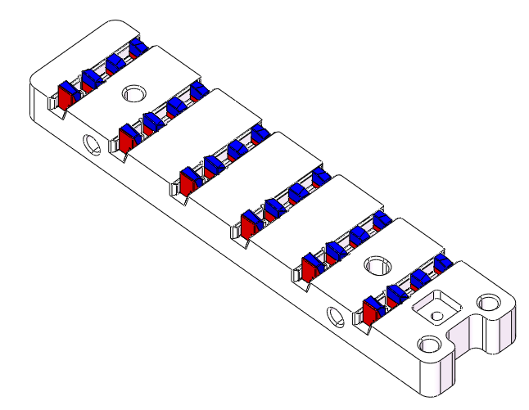
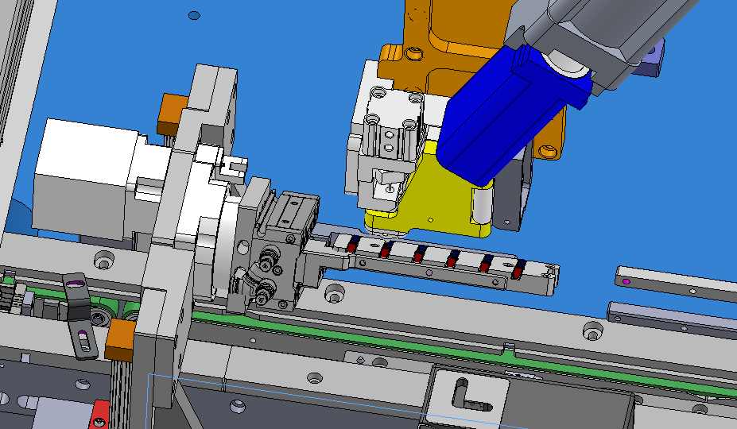
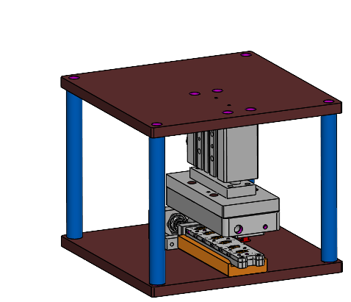
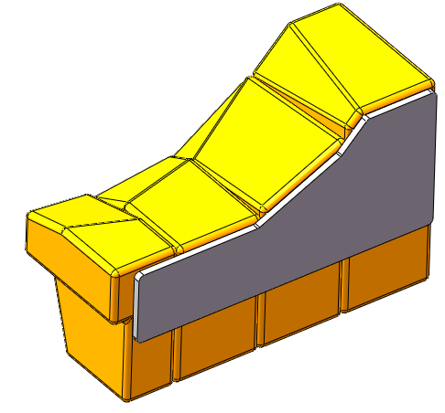
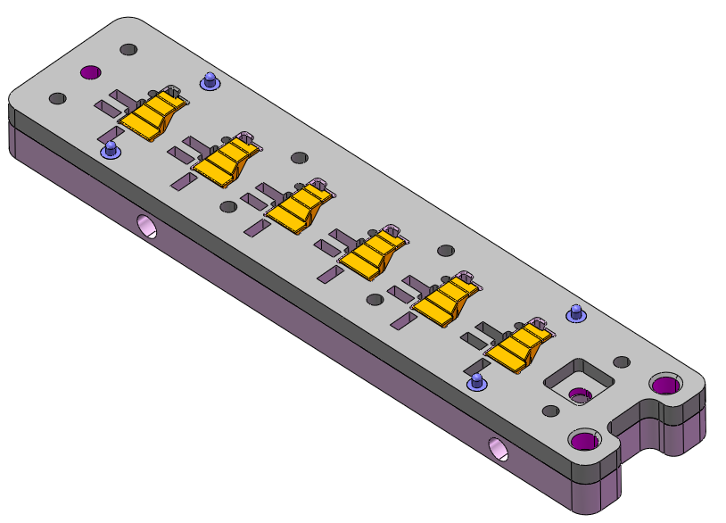
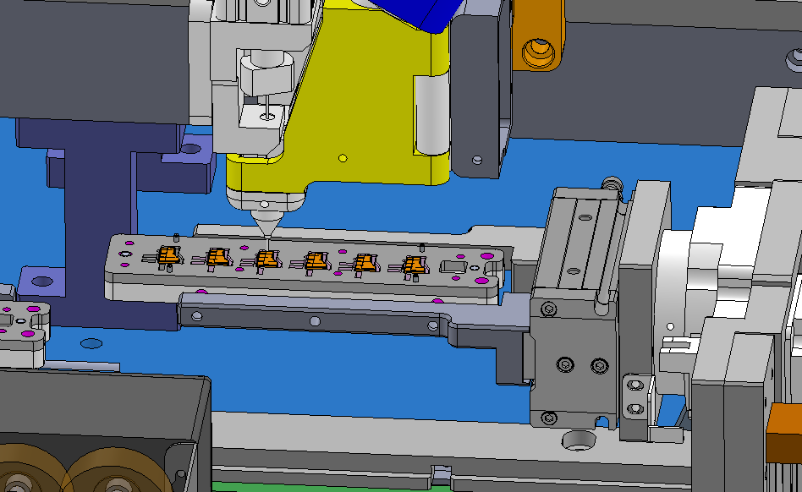
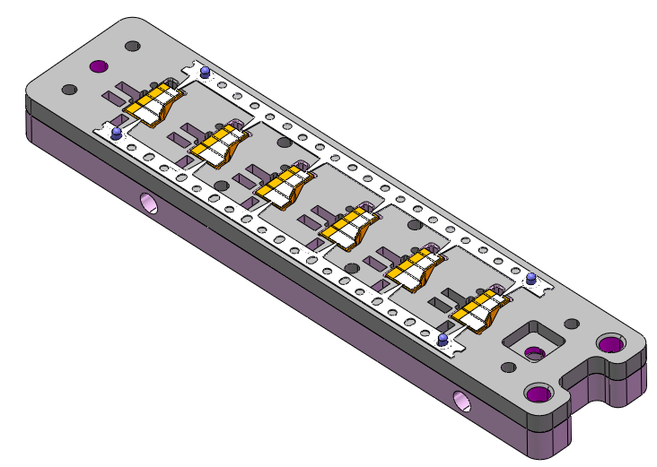
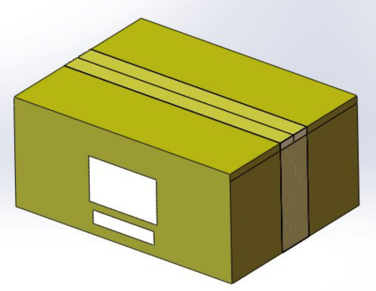
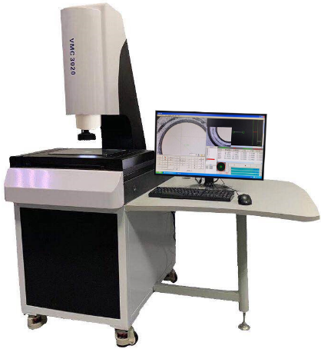
B747 BUD | Process Flow chart
Glue cleaning
(Laser)
Unloading
Semi-Product
Loading Magnet
Glue Dispensing
Hot Pressing
STEP-1
Loading
Semi-Product
Glue Dispensing
Shunt Loading
Hot Pressing
Unloading
Product
STEP-2
Packaging
Inspection
Glue Cleaning

Slide 5
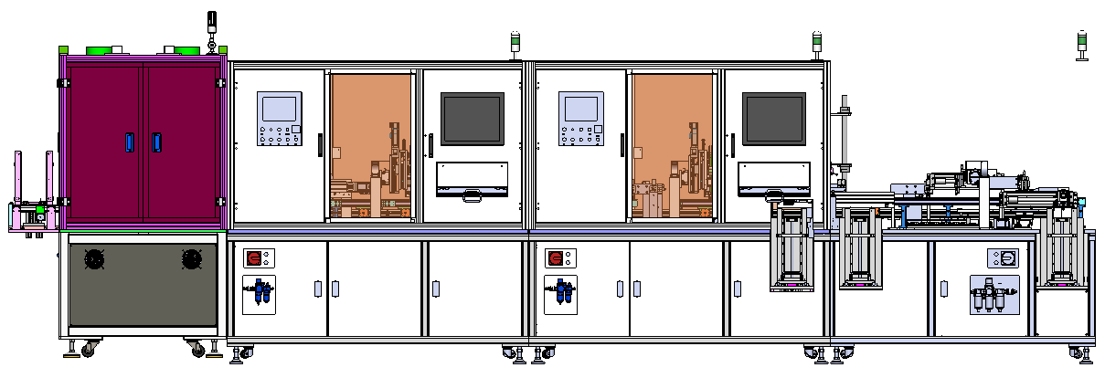
B747 BUD | Overview-STEP-1
MAG 4&3 Loading
MAG 2&1 Loading
Glue Dispensing
Hot Pressing
Glue cleaning & Unloading
1800
1500
1500
1500
1600
1800

Slide 6
B747 BUD | Overview-STEP-2
Semi-product loading
Glue Dispensing
Shunt Loading
Hot Pressing
1800
1800
1500
1000
1400

Slide 7
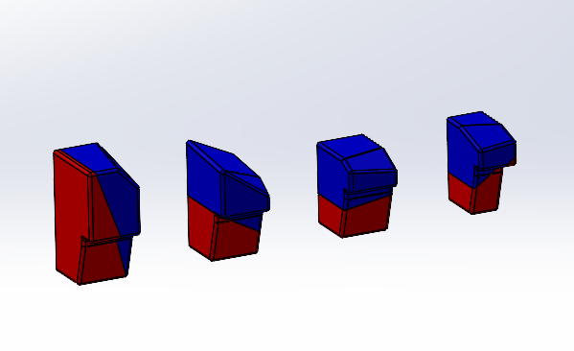
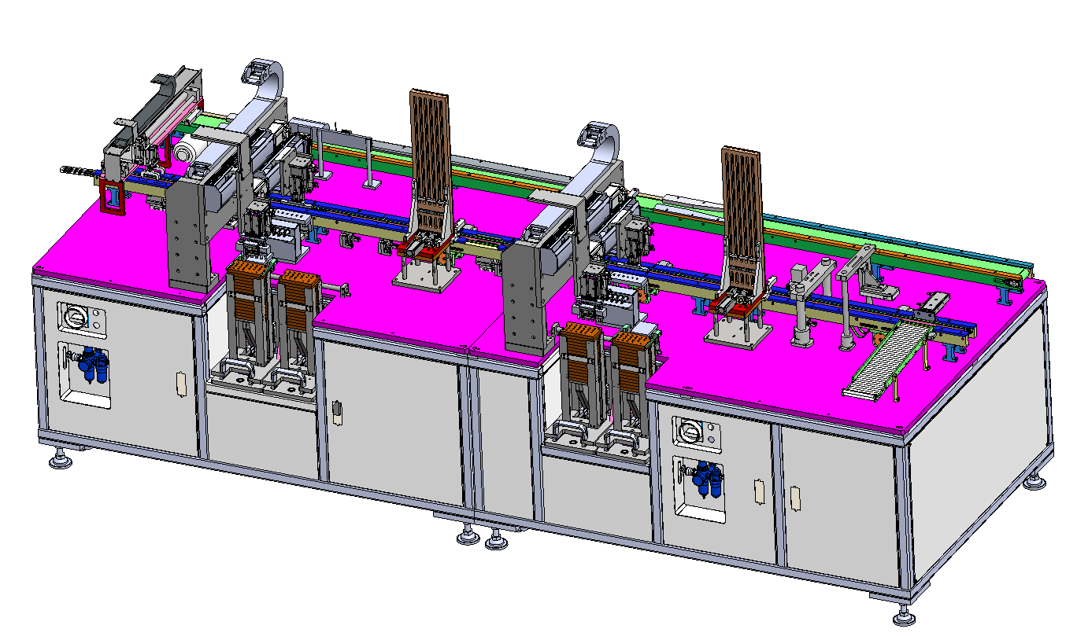
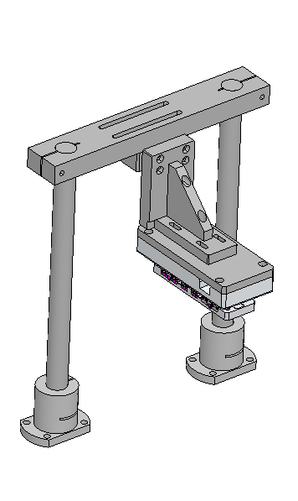
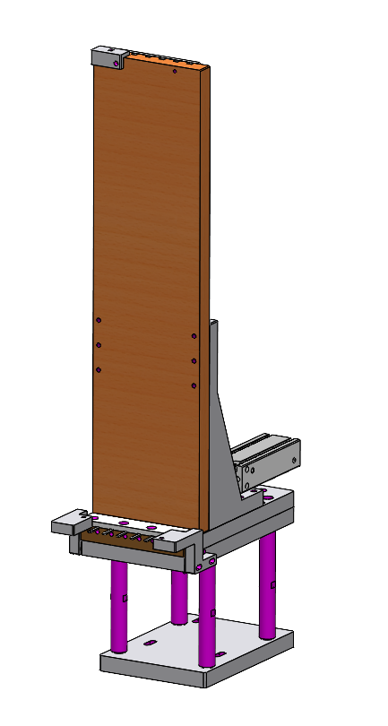
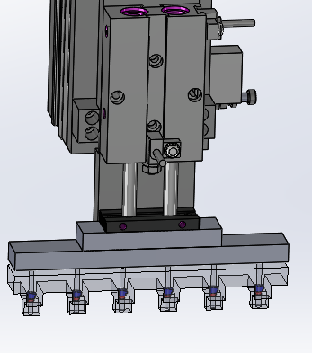
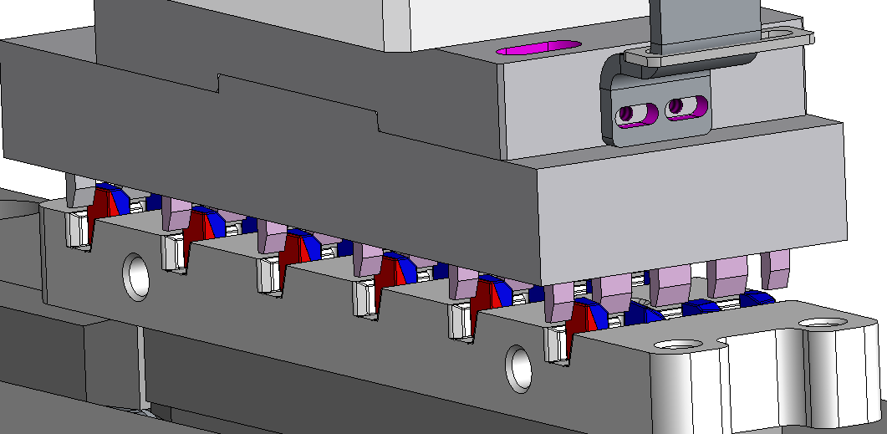
B747 BUD | STEP1- Loading Mag 1/2/3/4
Mag 4
Mag 3
Mag 2
Mag 1
Accurate
position
Polarity
detection
Tray 01
Clamp 02
Clamp 01
Tray 02
Fixture Material : SKD 11
Mag 4
Loading
Mag 3
Loading
Mag 2
Loading
Mag 1
Loading
Accurate
position
Polarity
detection
Magnets loaded

Slide 8
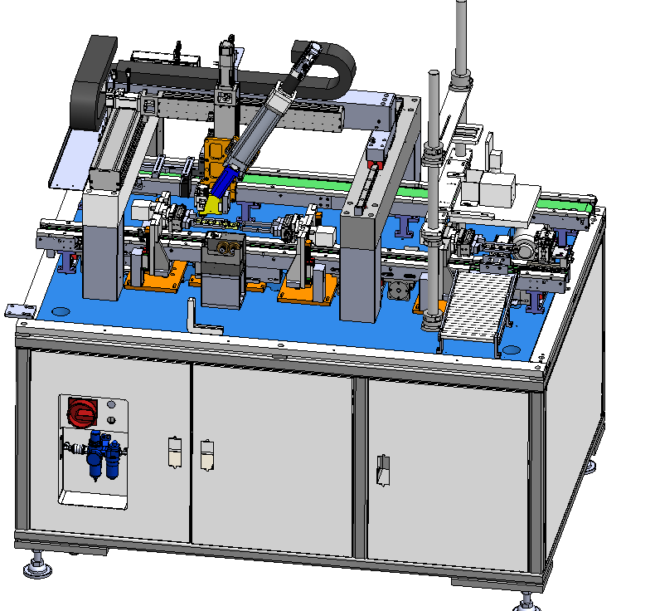
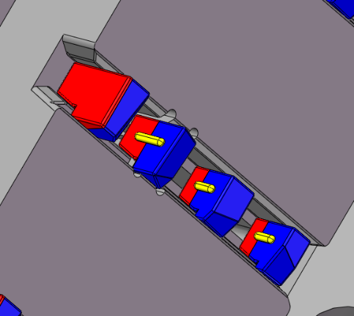
B747 BUD | STEP1- Glue Dispensing
The Step1 Glue Dispensing Parameter
Glue | Type | HHD 8540
 | Storage | 2-8 ℃
 | Glue amount | 0.75 ± 0.15 mg (a product)
 | Glue position | As picture (a point in center)
 | Open time | < 60 S
Glue Dispensing | Type | MK-451 (SZ)
 | Mix nozzle elements | 16
 | Needle | 22 G
Glue path detection
Glue path diagram
(yellow area)

Slide 9
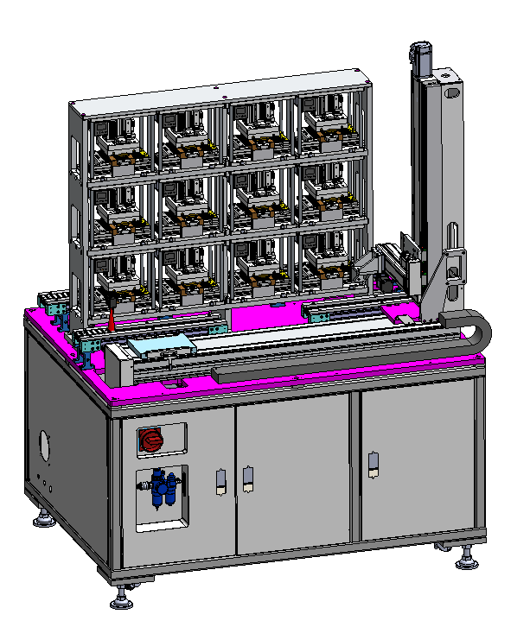
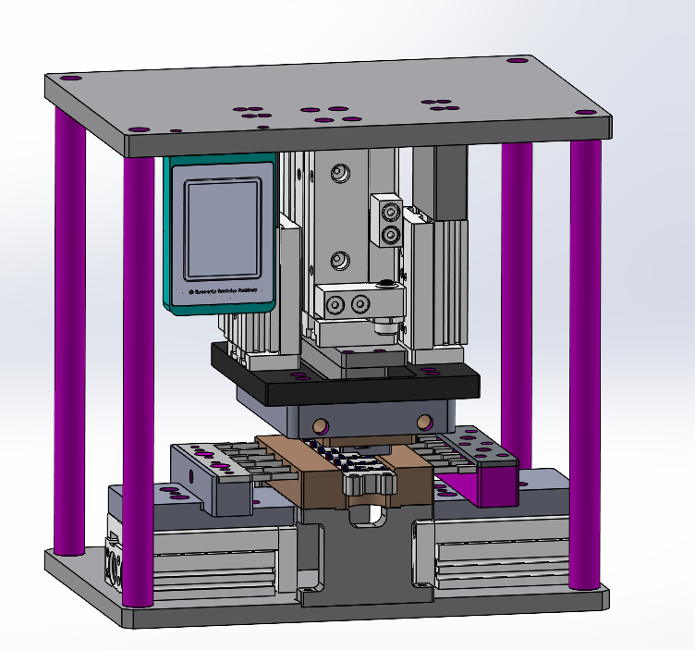
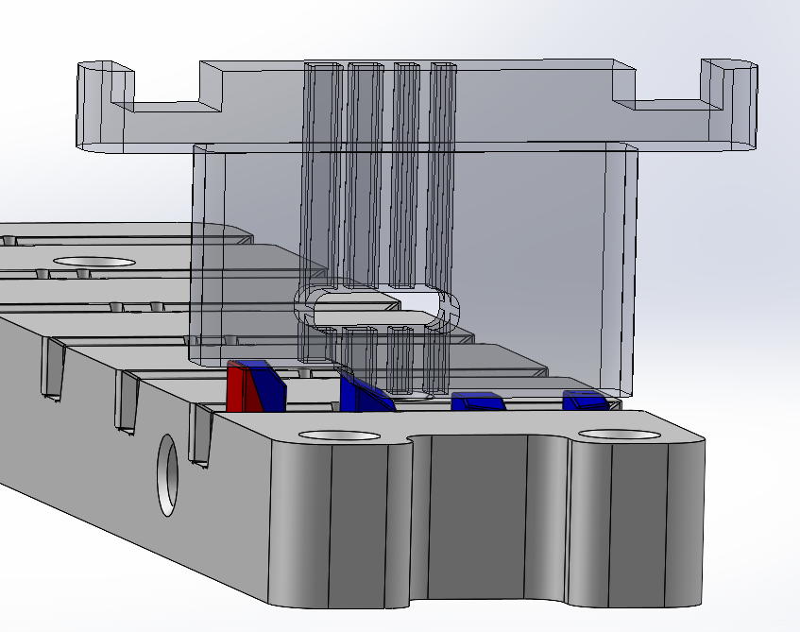
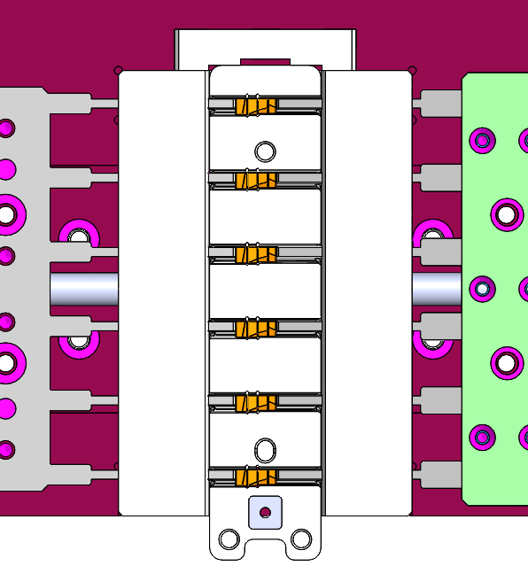
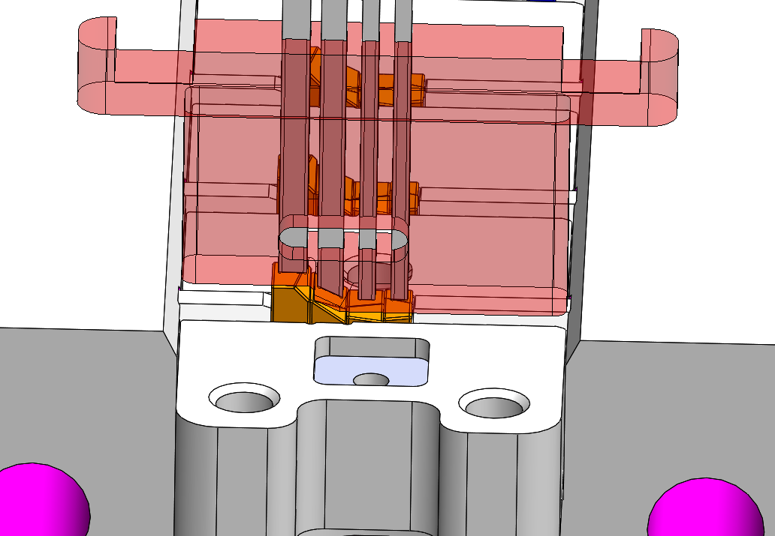
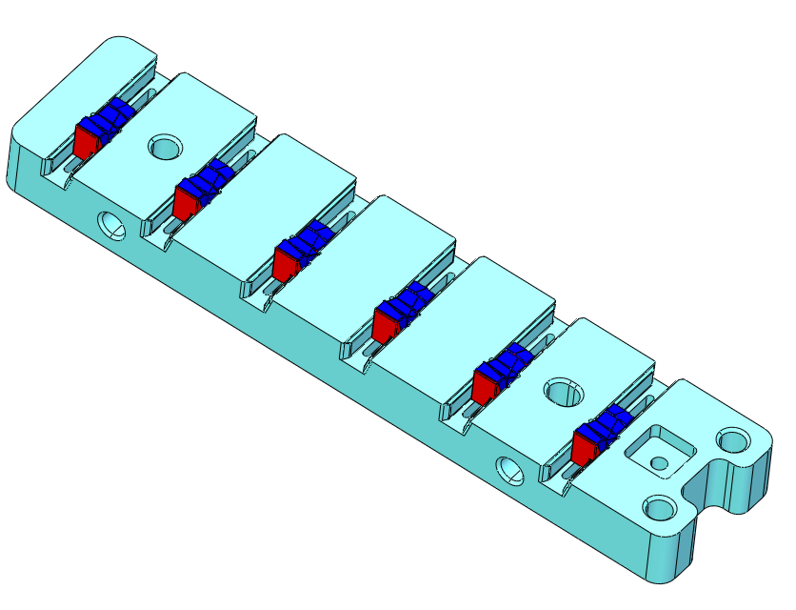
B747 BUD | STEP1- Hot Pressing
Air cylinder Type | TCM20X30S
Input air pressure | 0.4-0.6Mpa
Time | 80s
Temperature | 80±5℃
Robot
Hot pressing chamber
X12
Put the fixture into the hot pressing chamber
Prepressing
Side push
Pressing
Heating
Take the fixture out of the hot pressing chamber

Slide 10
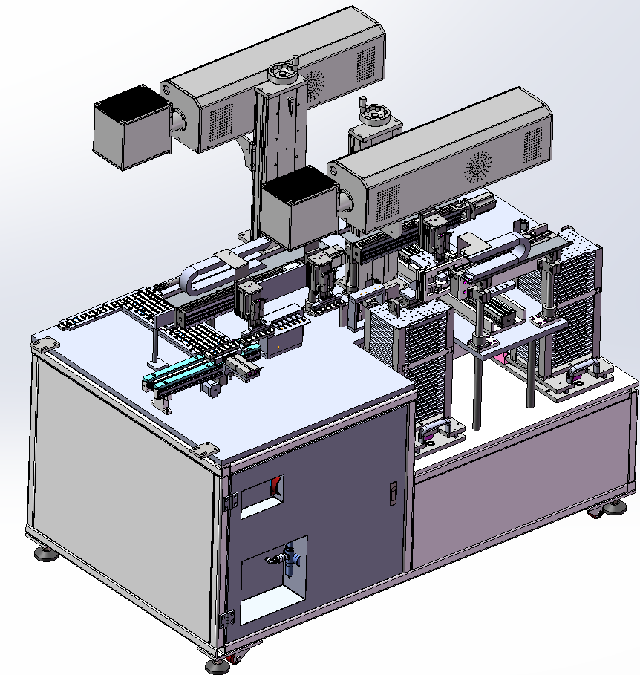
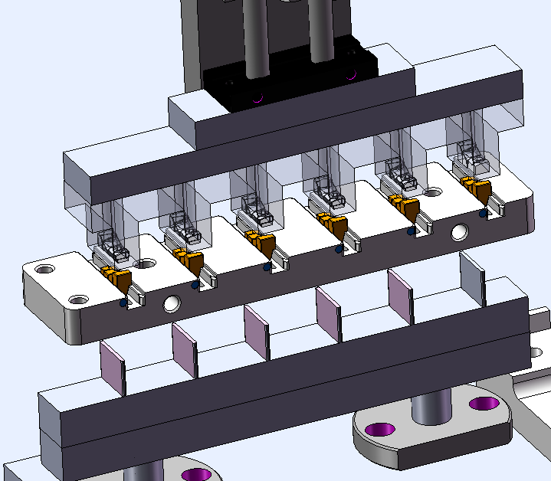
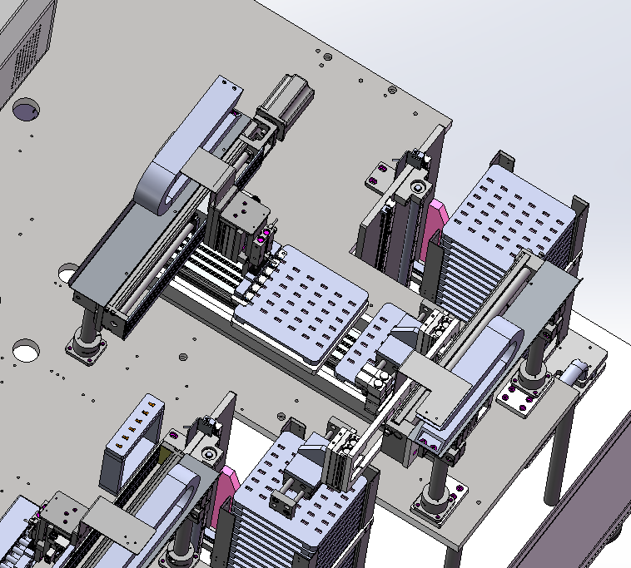
B747 BUD | STEP1- Product glue cleaning and tray loading
Glue cleaning parameters
Glue cleaning Machine | Name | Laser cleaning machine
 | Type | GM-C02-60-MR
 | Vendor | Guoyu
 | Rated power | 60 W
Parameters | Laser power | 42~54 W
 | Laser speed | 2500~4000 mm/s
 | Q frequency | 10~20 KHz
 | Fill the gap | 0.025~0.04 mm
Laser device
Return the empty fixtures
Full Tray
with products
Empty Tray
Incoming fixtures with products
Products in the fixture
Draw the product from the fixture
Glue cleaning by laser
Put the cleaned products into the tray
Full tray with products

Slide 11
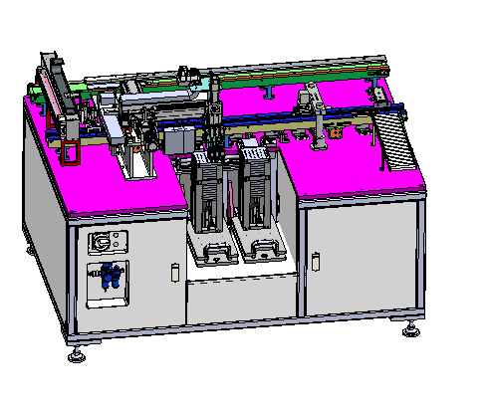
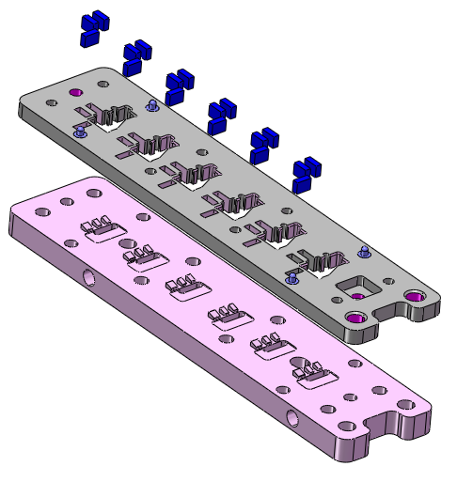
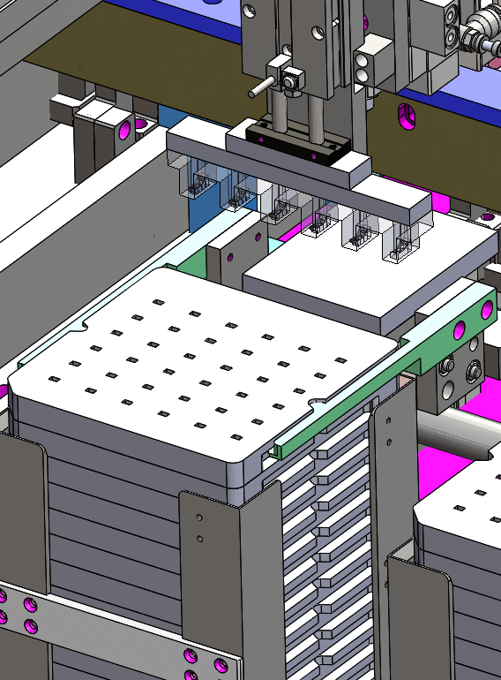
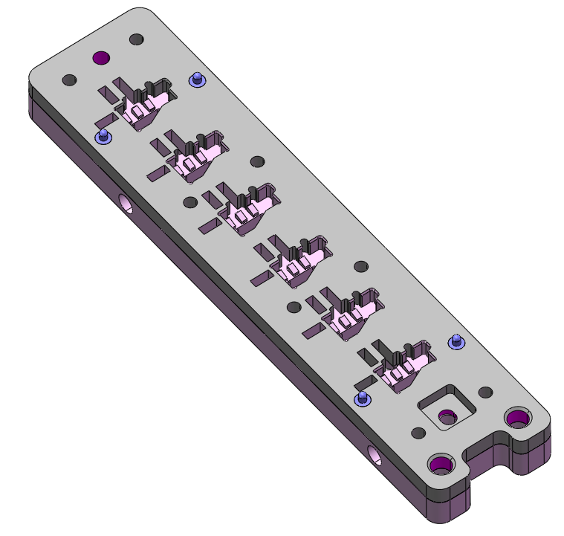
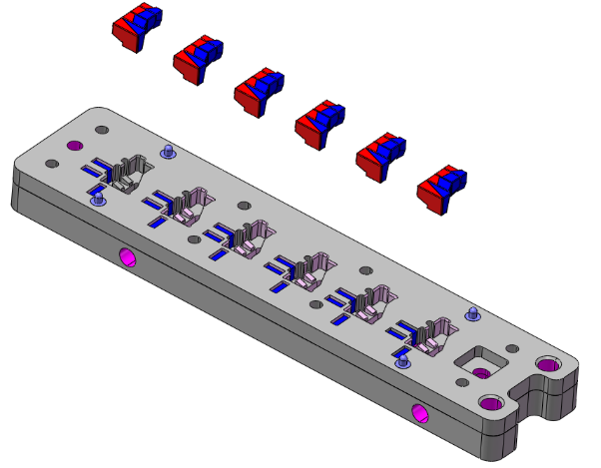
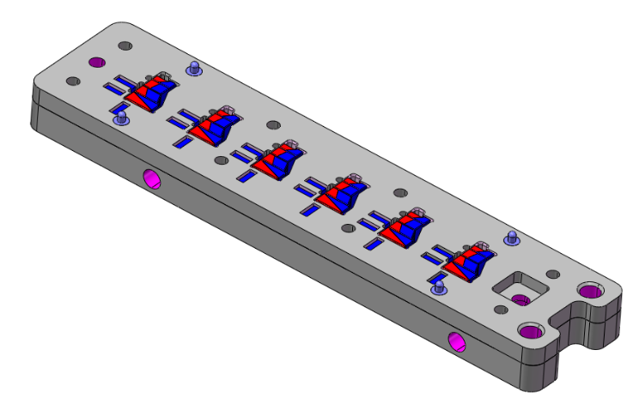
B747 BUD | STEP2 – Semi-product loading
The Step-2 fixture design overview
18x fool-proofing magnets
Shortage detection
Fixture Cover
Material: SUS304
Semi-product tray
Fixture base
Material:SUS304
Empty fixture
Draw the smei-product from the tray
put the smei-product into the fixture
The smei-product loaded
Detect the shortage by Hall Coil

Slide 12
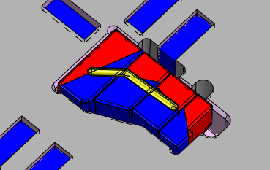
B747 BUD | STEP2 - Glue Dispensing
The Step2 Glue Dispensing Parameter
Glue | Type | HHD 8540
 | Storage | 2-8 ℃
 | Glue amount | 1.10 ± 0.2 mg (a product)
 | Glue position | As picture (a point in center)
 | Open time | < 60 S
Glue Dispensing | Type | MK-451 (SZ)
 | Mix nozzle elements | 16
 | Needle | 22 G
Glue path detection
Glue path diagram
(yellow area)

Slide 13
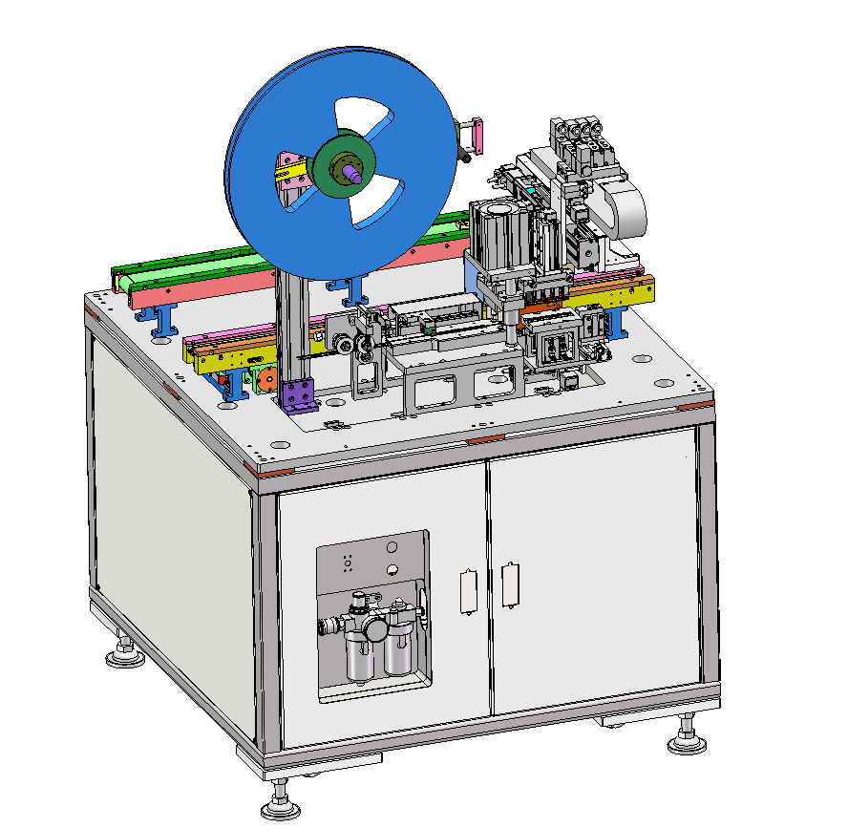
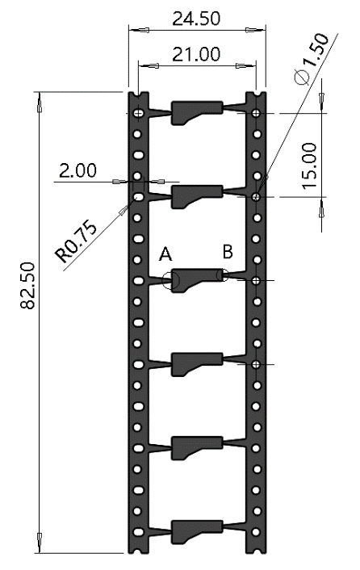
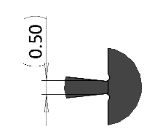
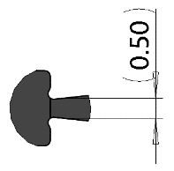
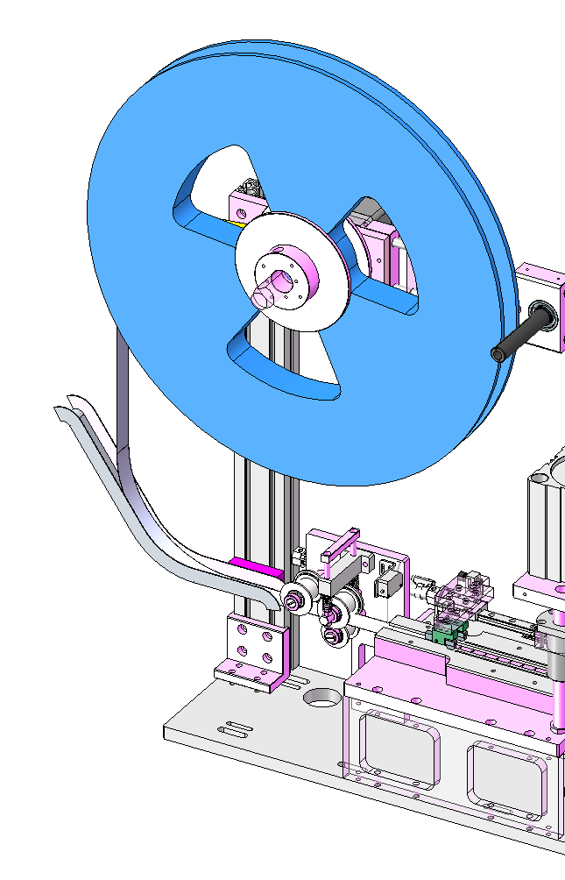
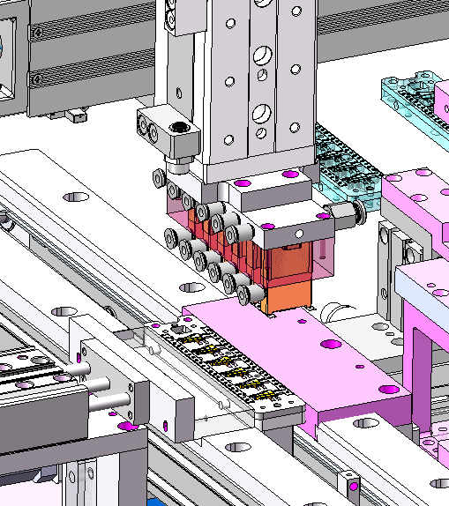
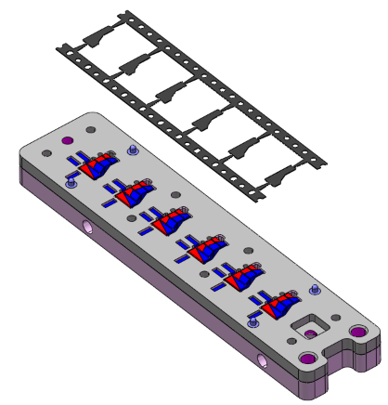
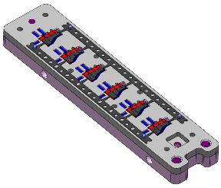
B747 BUD | STEP2 – Shunt loading
Shunt Carrier design overview
Shunt Carrier Disc
Shunt Suction Nozzle
V -CUT
V -CUT
Local view A
Local view B
Shunt Carrier
The shunt carrier disc conveys the shunt carrier
The shunt suction nozzle draws the shunt carrier
Put the shunt carrier on the product fixture
The shunt carrier attached on the product fixture

Slide 14
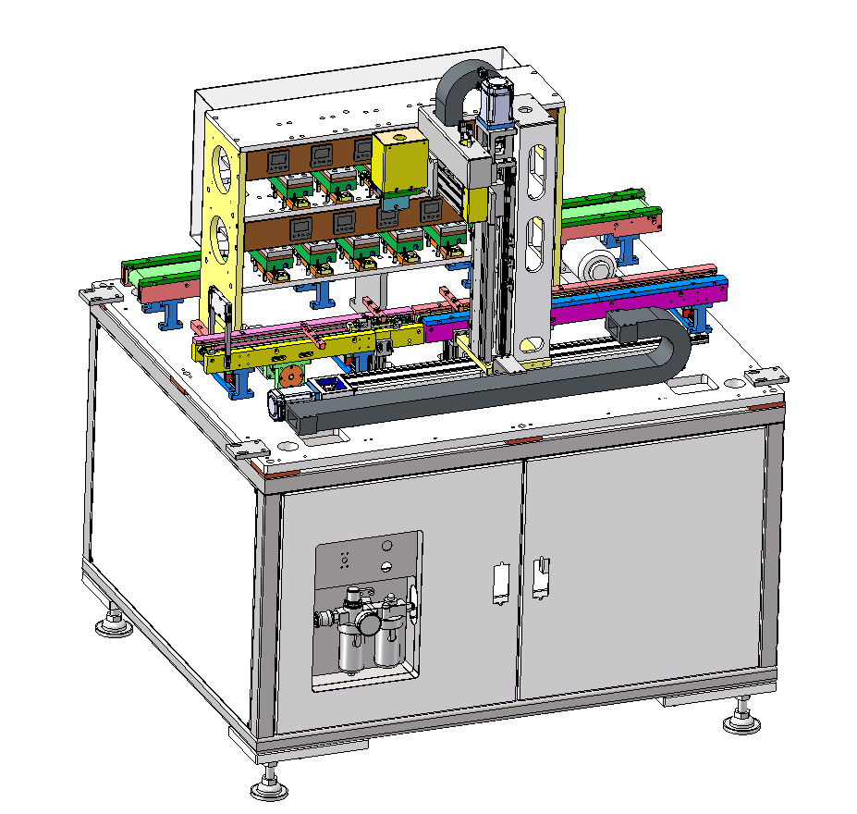


B747 BUD | STEP2 – Hot Pressing
Robot
Input air pressure | 0.4-0.6 MPa
Time | 80s
Temperature | 80±5℃
Hot pressing chamber
Put the fixture into the hot pressing chamber
Hot pressing
Take the fixture out of the hot pressing chamber

Slide 15






B747 BUD | STEP2 - Product Unloading
Remove the carrier waste
The products unloaded from the step2 fixture
Carrier waste
Carrier Location
There is a gap at the edge after breaking
There is a gap at the edge after breaking

Slide 16



B747 BUD | Process Description - Glue Cleaning
Laser device
Robot
Glue cleaning station
Automatic glue cleaning machine
Glue cleaning parameters
Glue cleaning Machine | Name | Laser cleaning machine
 | Type | GM-C02-60-MR
 | Vendor | Guoyu
 | Rated power | 60 W
Parameters | Laser power | 42~54 W
 | Laser speed | 2500~4000 mm/s
 | Q frequency | 10~20 KHz
 | Fill the gap | 0.025~0.04 mm
Products loading tray
Products unloading tray
Final Product

Slide 17


B747 BUD | Process Description - Inspection
OMM Dimension Test
SST Tester
Flux Density Test
Polar Pen

Slide 18



B747 BUD | Process Description - Packaging
Product 64x
Tray x1
Packing 4 trays with a wrapping film
Qty:6 Layer*4 Tray/Layer* 64Pcs/Tray=1536pcs
Place the products into tray
Qty:64Pcs

Slide 19
Thank you !

